Slide 1
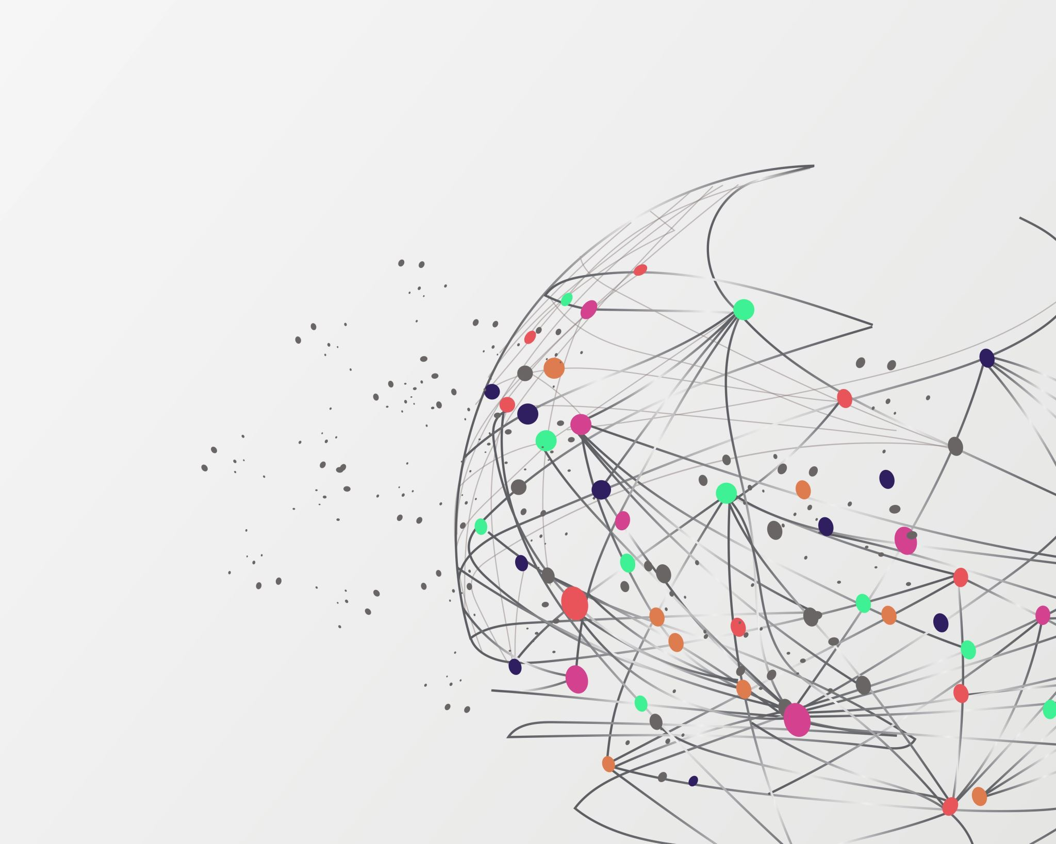
THE INTRACTIONOF DATASCIENCE AND IOT

Slide 2

INTRODUCTION
Data Science and IOT converge transforming industries .

Slide 3
IoT Data Generation
Generate massive data
Wearables devices
Industries machine

Slide 4
Data Science in IoT
Decode raw IoT Data
Extracting valuable insight
Decision Making
Empowering Organization

Slide 5
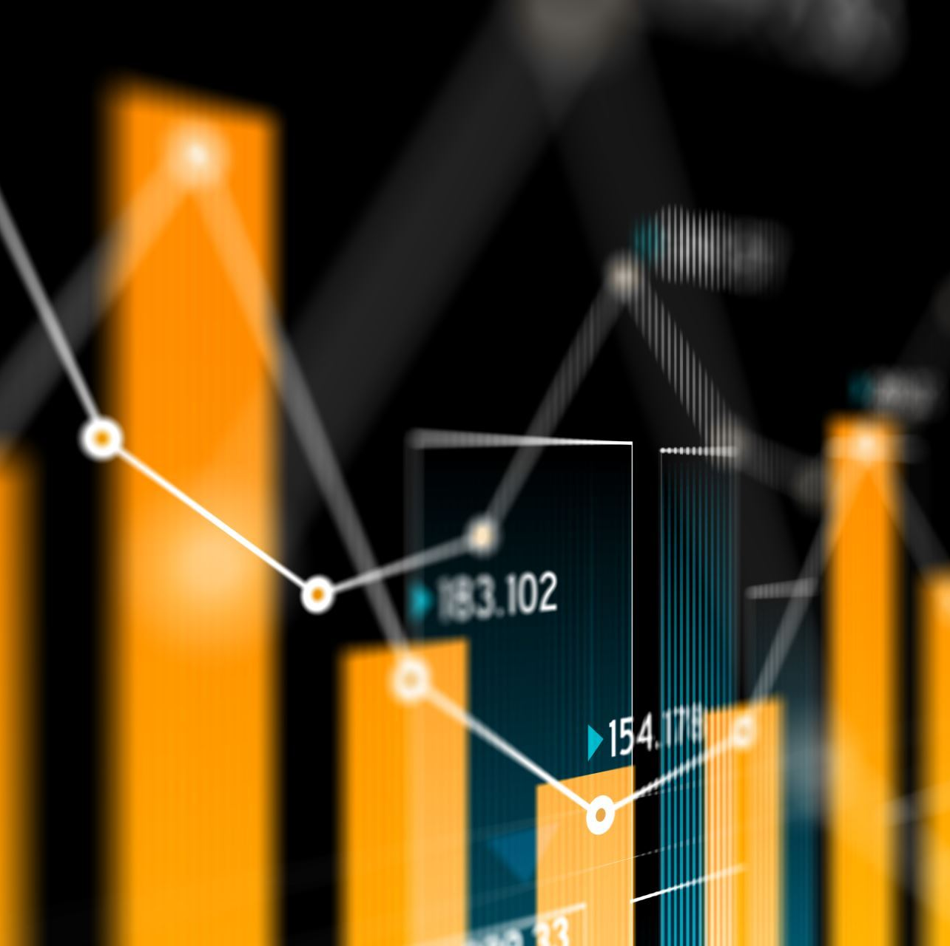
Real – Time Data Analytics
Provides immediate insights
Optimizing operations
Monitor equipment
Various Industries

Slide 6
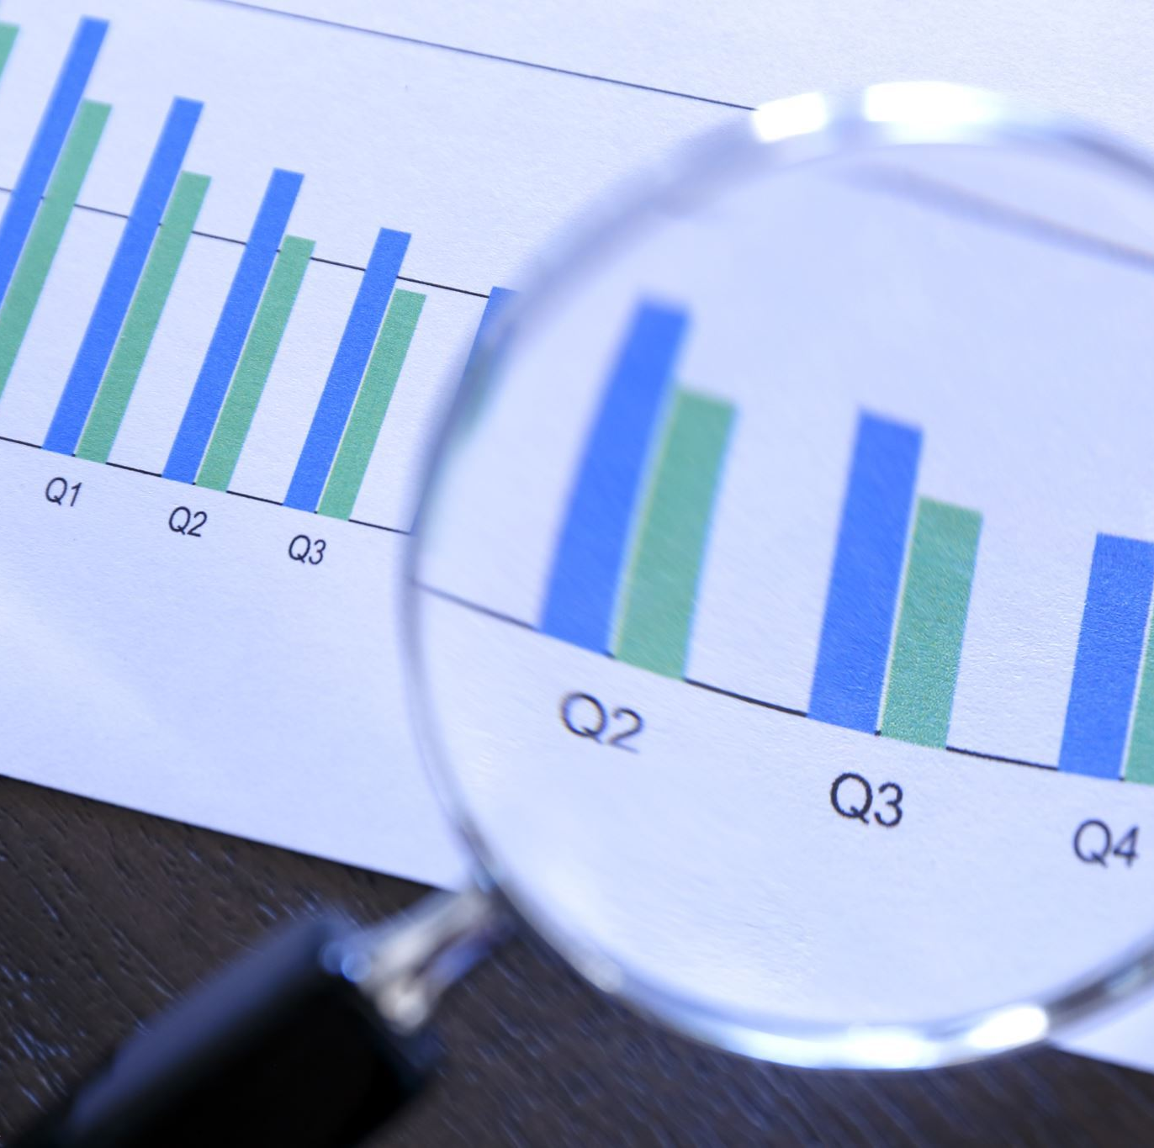
Predictive Analytics
Anticipates equipment's failure
Reducing downtime and Maintenace's cost
Extend the lifespan

Slide 7
ML AT THE EDGE
ML at the edge of IoT network enables
Swifts
Low-latency
Decision making

Slide 8
SECURITY AND ANOMALY DEDCTION
Securing IoT eco-system
Detect anomalies in data patterns
Defense against cyber threads
Ensure integrity of IoT System

Slide 9

CUSTOMIZATION AND PERSONALIZATION
Personal experience based on user behavior
Enhance user satisfaction

Slide 10
IOT AND DATASCIENCE IN VRIOUS SECTOR
Industrial 🏭 IoT
Healthcare
Smart agriculture
Energy management

Slide 11

HEALTHCARE APPLICATIONS
IoT Enhance patient care
Data Science analysis patient data
Improve diagnostics and treatment plans

Slide 12
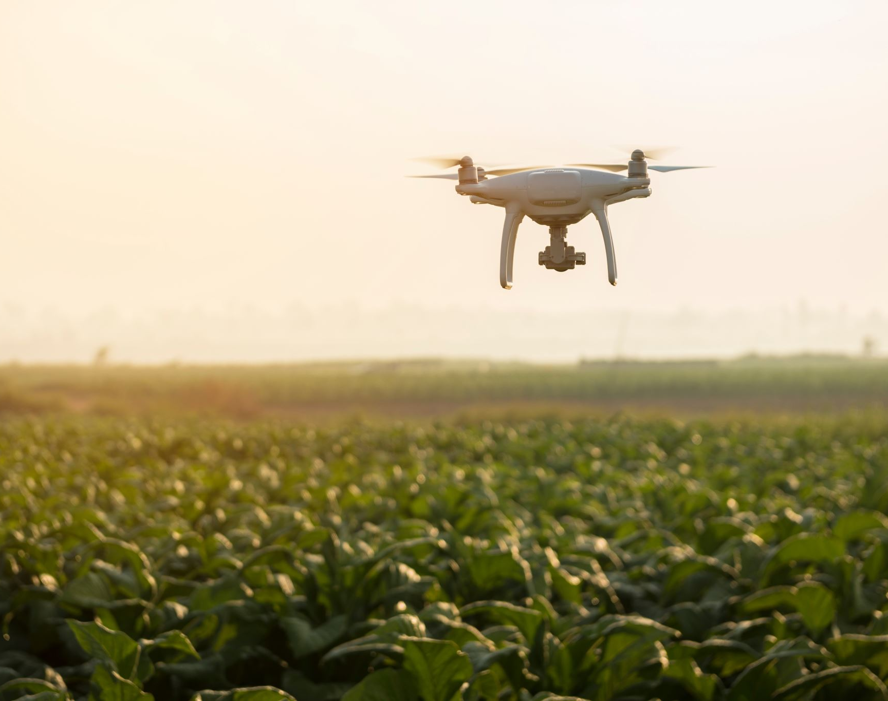
SMART AGRICULTURE
Improve crop yield
Resource efficiency
Pest controls
Smart irrigation system

Slide 13

ENERGY MANAGEMENT
IoT enhance energy management
Data Science optimize consumption, predicts demands

Slide 14
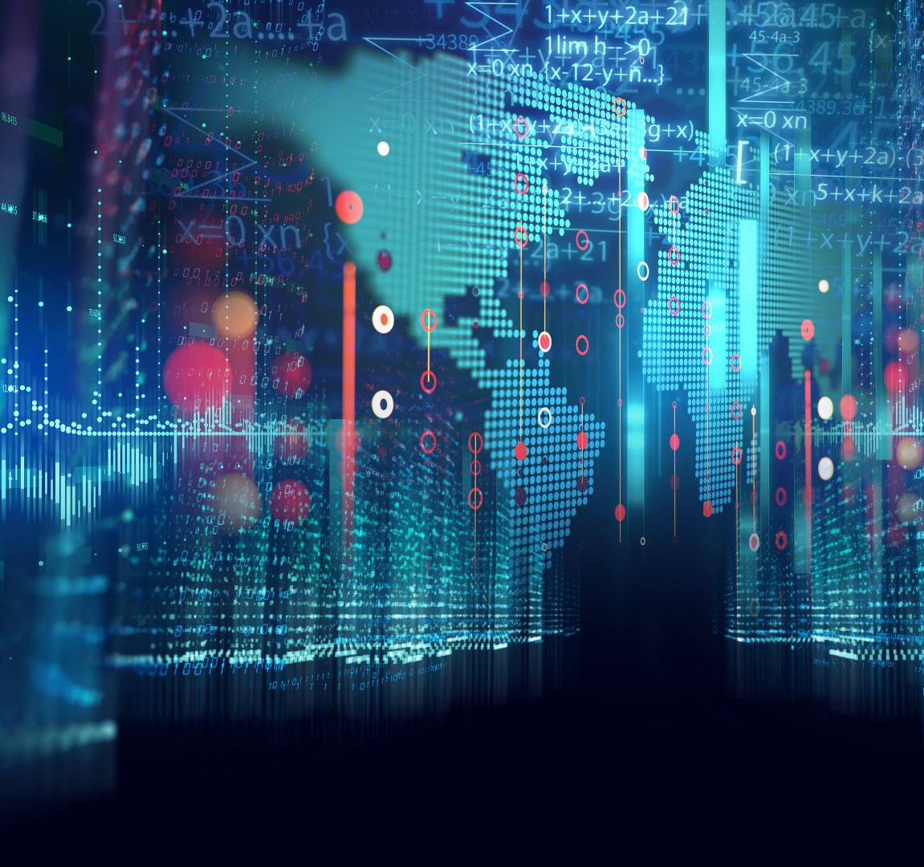
SMART CITIES
IoT shapes smart cities
Data – driven solution
- optimize traffics 🚥 flow
- reduce pollution

Slide 15
RETAIL OPTIMIZATION
Inventory management
Supply chain optimization
Customer Experience Enhancement
Customer Insights

Slide 16

ENVIROMENTAL MONITORING
IoT monitors environment
Data Science aids in analysis
Climate data
Tracking pollution levels

Slide 17
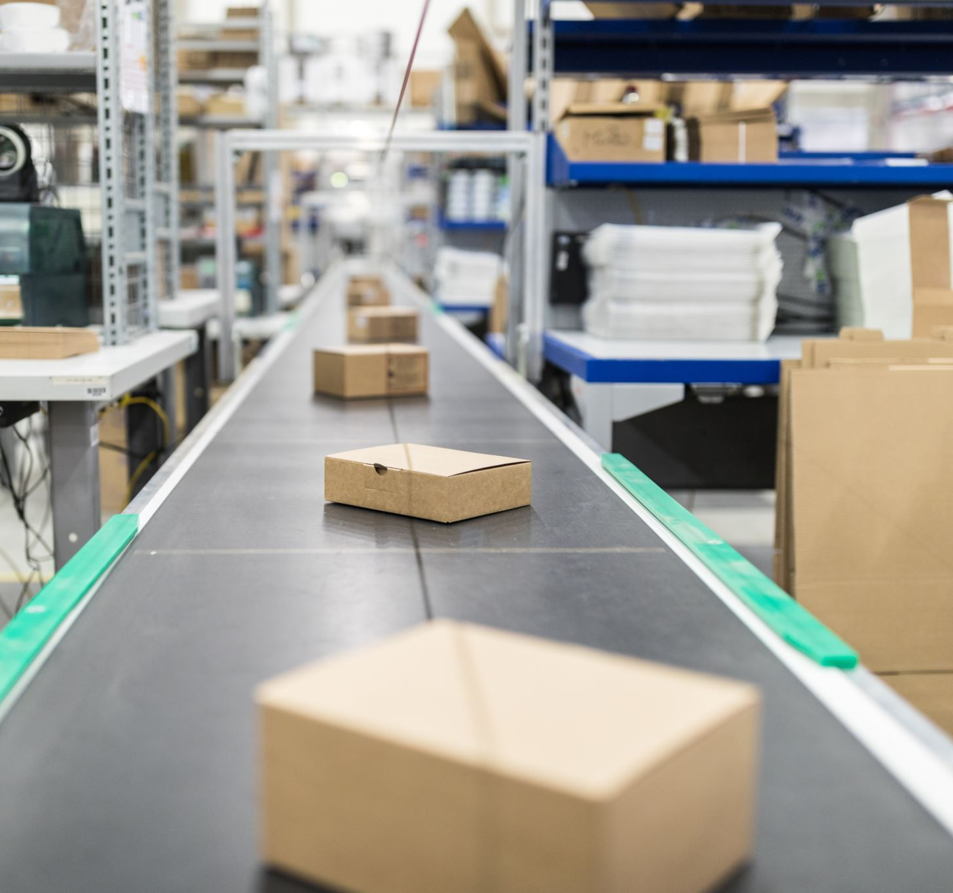
TRANSPORTATION INNOVITATION
IoT transform transportation
Data-driven solution improve logistics, enhance

Slide 18

FUTURE POSSIBILITIES
The future possibilities are limitless

Slide 19
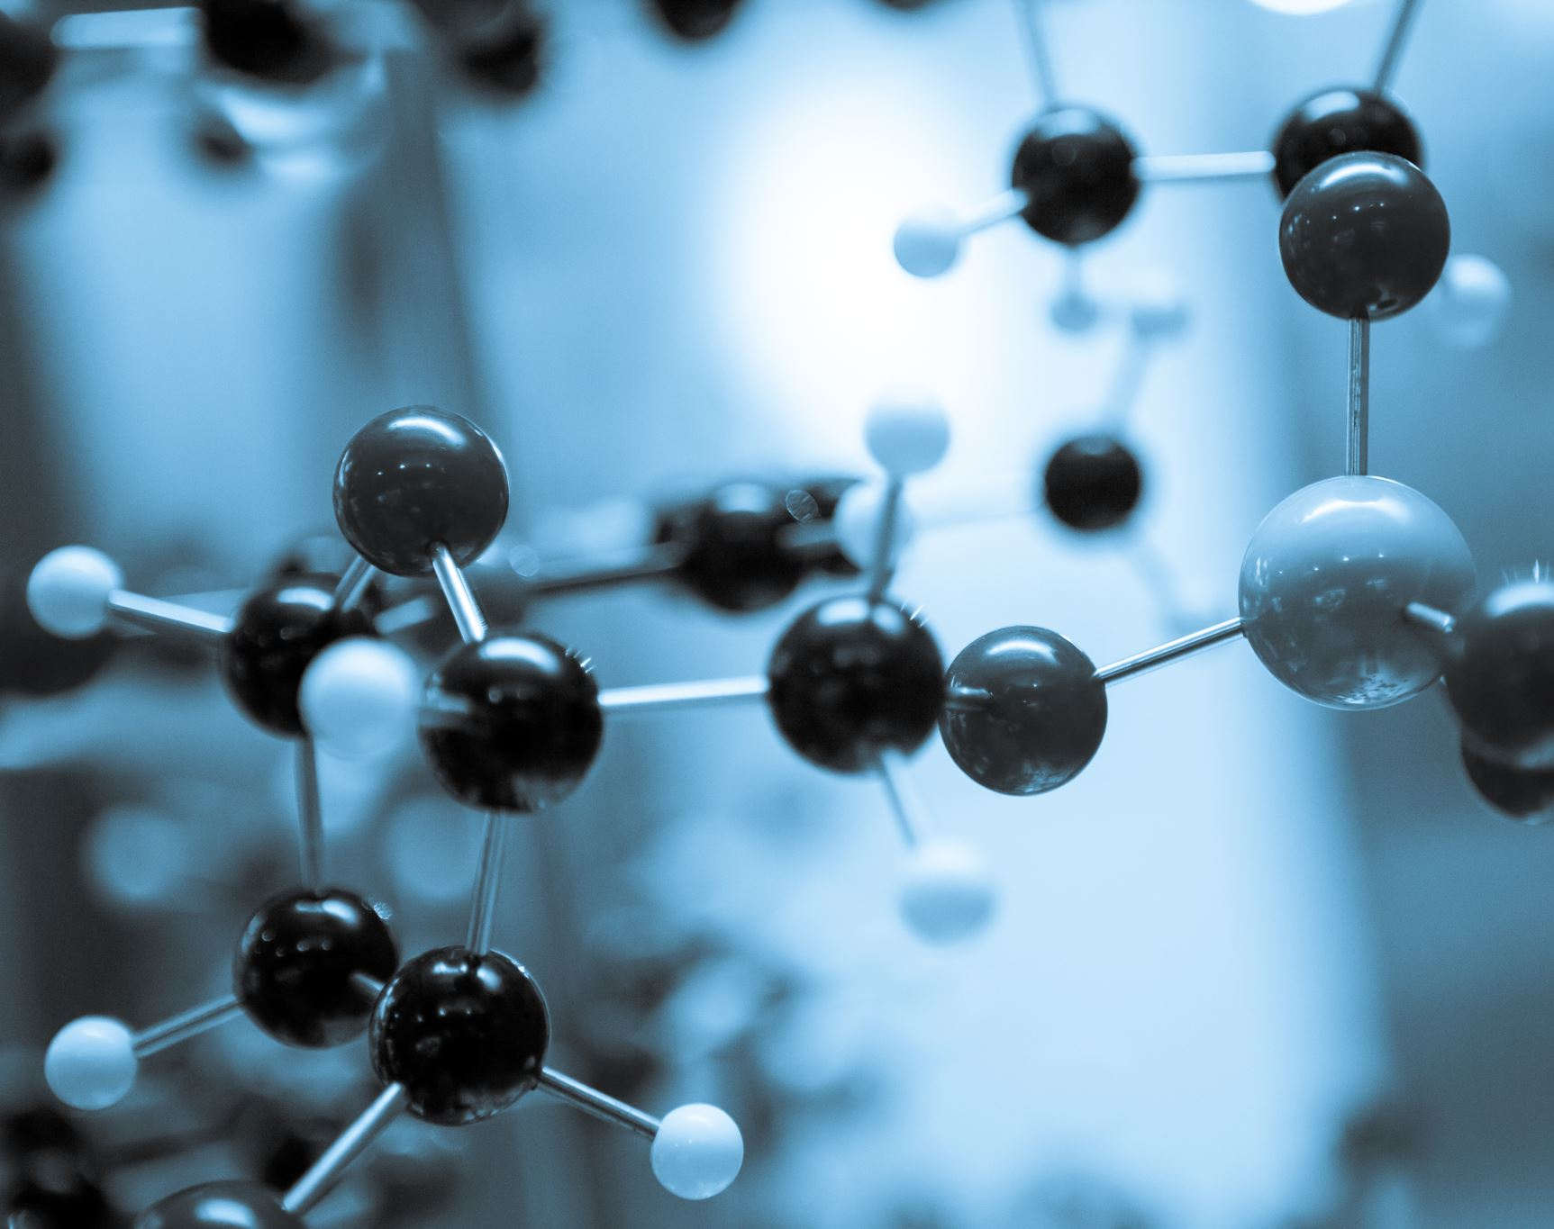
CONCLUSION
The synergy of Data Science and IoT
reshapes industries
Fostering innovation
And efficiency

Slide 20

THANK YOU

